Slide 1
Customer Segmentation based on LTV
By Hennadii Korolevych

Slide 2
About the data
The data set contains the results of an auto insurance company's marketing campaign to retain customers by offering customers with expiring policies one of four different renewal proposals.
9134 customer records
24 variables (14 policy profile variables and 10 customer profile variables)

Slide 3
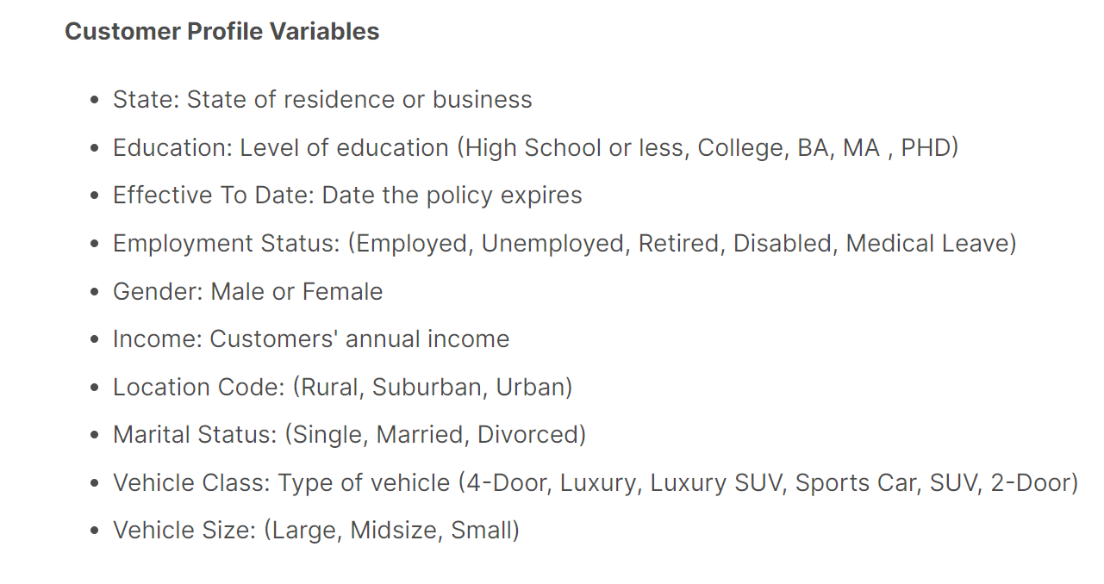

Slide 4
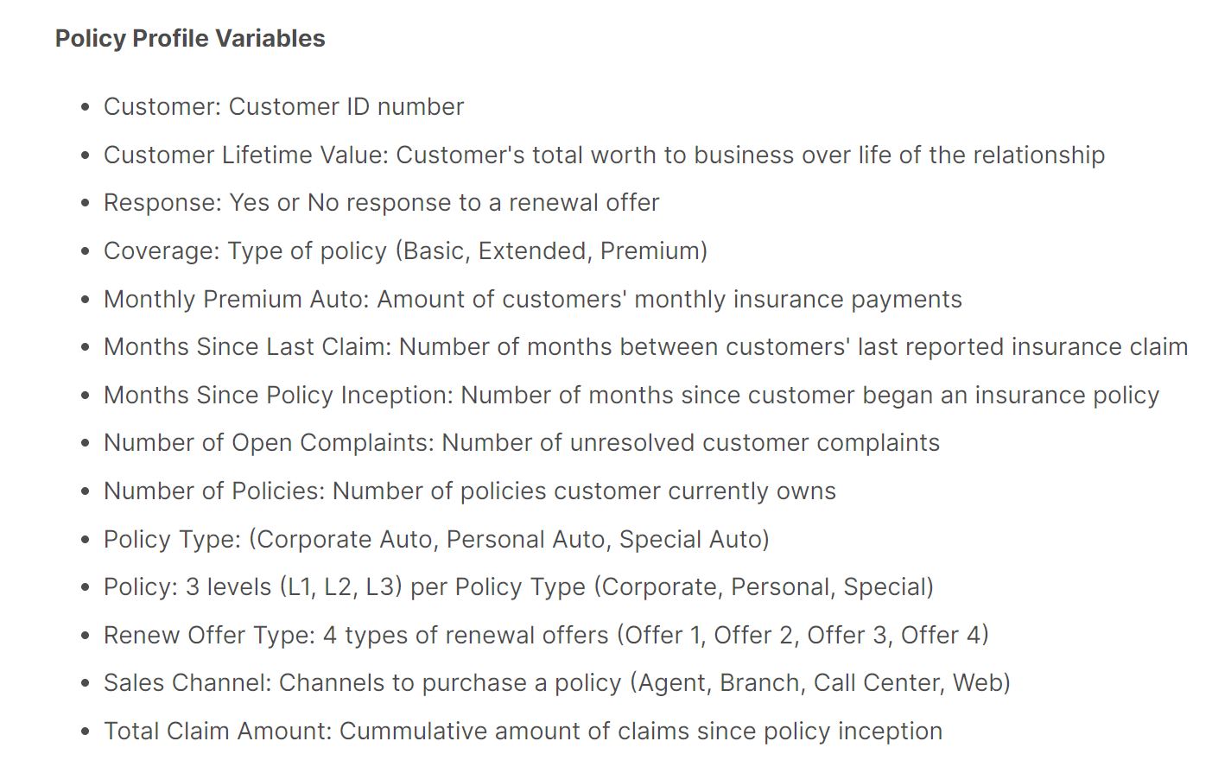

Slide 5
LTV prediction benefits
Know the Future: Who Will Become Your Most Valuable Customers?
Improving Customer Segmentation Strategy
Marketing Strategies & Overall Ad campaign optimization
Increase in Sales, Profits and Retention rate

Slide 6

Thank you!

